Slide 1
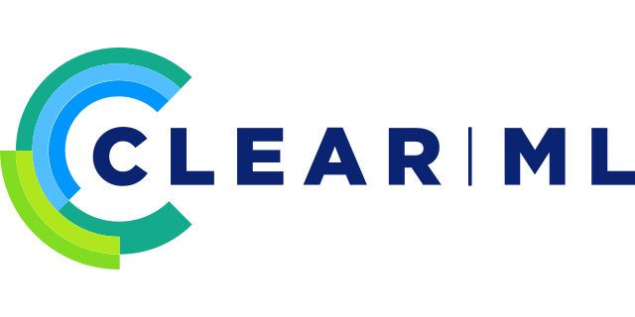
ML-Ops with ClearML
for Movie Rating Predictions
10th November 2022
Davidson Siga, Graduate Student @ CMU
For the ML in Production Class , CMU (17-645)
Notes:
Hi Everyone, I’m Davidson Siga , Graduate Student at Carnegie Mellon University.
In this video I’m going to introduce you to how ClearML can provide great Machine Learning Operations Support to your Machine Learning Problem.

Slide 2
An ML Problem : Movie Rating Prediction
ClearML : ML-Ops for efficient productionizing
Integration : ClearML + Movie Rating Prediction
The Strengths and Limitations of the tool
Notes:
The agenda of this video is as follows ,
We shall discuss
The machine Learning problem we were trying to solve
I will introduce you to Clear ML and what will it bring to our team
I will illustrate how the tool is useful in a production machine with Evidence that the tool was tried on data from a movie streaming scenario.
Lastly, will talk about The strength and limitations of the tool

Slide 3
An ML Problem Movie Rating Prediction
Notes:
Imagine you’re a team of 5 , solving a Machine learning problem, in this case I will take the example of a Movie Rating Prediction Problem.

Slide 4




Predicting Movie Ratings
Movie Ratings
Information
Movie Ratings
Database
Machine Learning
Model Fitting
New Movie’s
Rating Prediction
Idea of Machine Learning Prediction:
Learn on data which looks like : User 1 watches Movie 1 and rates it 4/5 stars
If we give model the Features : Demographics of User and Movie Details
It will give us the Outcome : Prediction (1-5 Stars)
Notes:
Lets think about how the data is coming to us,
First, the movie ratings information is collected on devices by the users,
It is moved to cloud and structured well
We will download the data to our system and analyze ,process and prepare the data for Prediction
The idea is simple, Machine Learning Models will take this data and learn how to predict the rating if a particular set of features were provided to it.
Features here are the Demographics of User and Movie Details
It will give us the Outcome : Prediction (1-5 Stars)

Slide 5
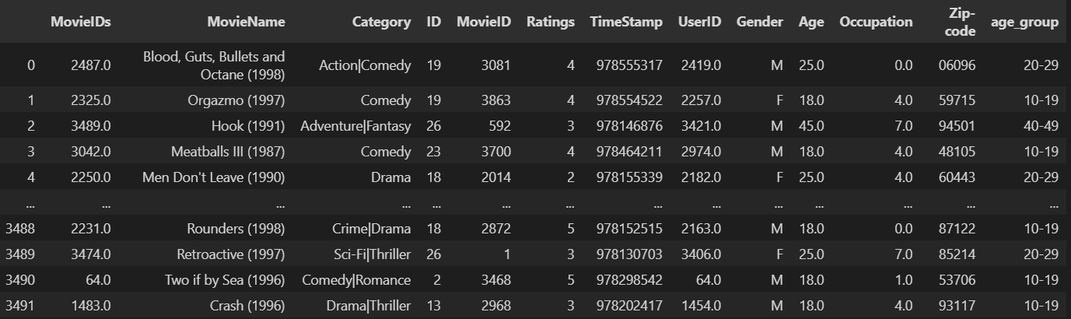
Looking at the Data In hand
Sourced form : https://www.kaggle.com/code/sherinclaudia/movie-rating-prediction/data
Notes:
Here’s an example of how the data I’m using will look like. The data was downloaded and processed from the Kaggle link provided.

Slide 6
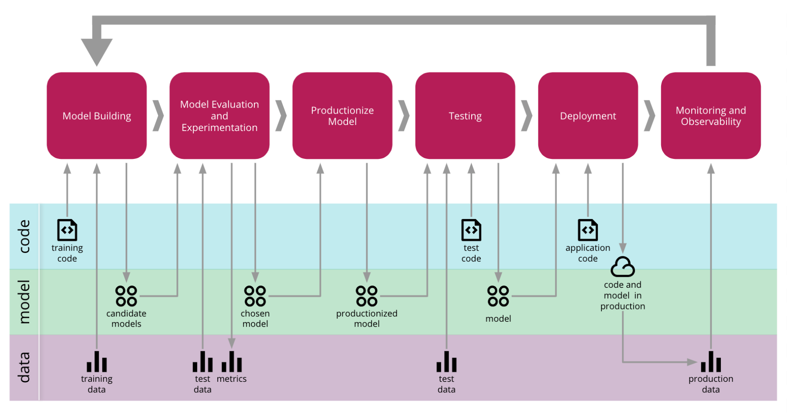
ML Engineering in General
Source : https://martinfowler.com/articles/cd4ml.html
Notes:
In general, Machine Learning Model building has multiple phases.

Slide 7
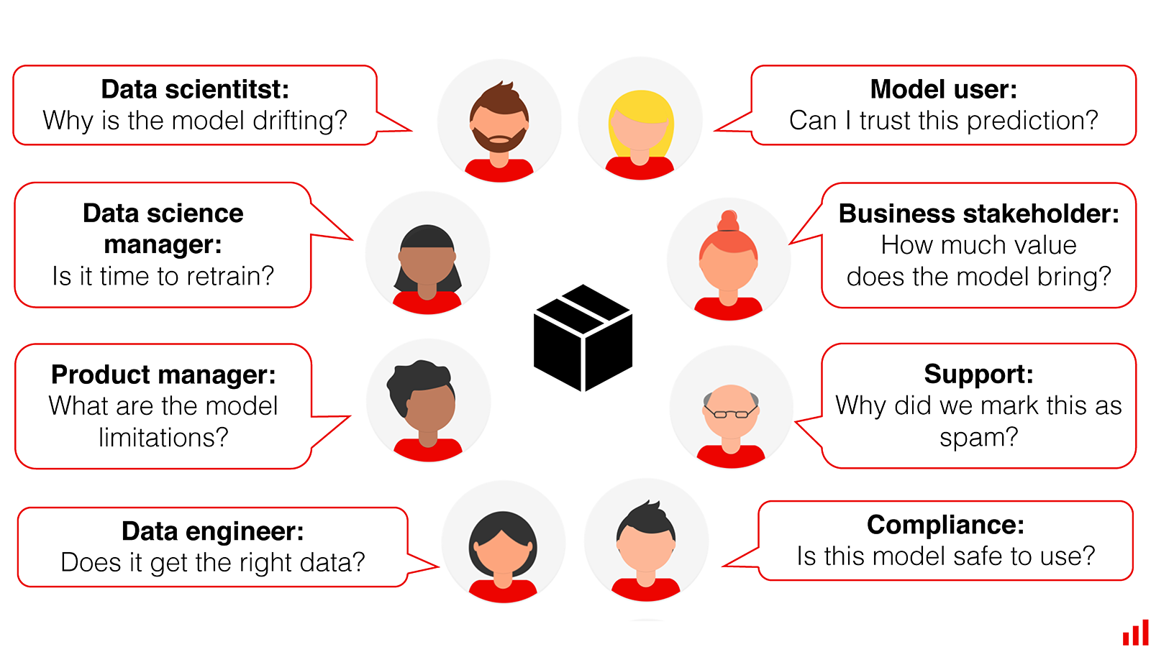
Many Stakeholder, Many Coders = Chaos!
Source : evidentlyai.com/blog/machine-learning-monitoring-who-should-care-and-what-we-are-missing
Notes:
The challenge that often occurs is that when many coders and stakeholders work together, it causes chaos.
In order to control the movement of information and structure our workflow, we utilize ML Ops tools.

Slide 8

ClearML
ML-Ops for efficient productionizing
Notes:
Clear ML is a ML Ops took for efficient productionizing of ML workflows. It has many clients in the Fortune 500 space and is growing rapidly.

Slide 9
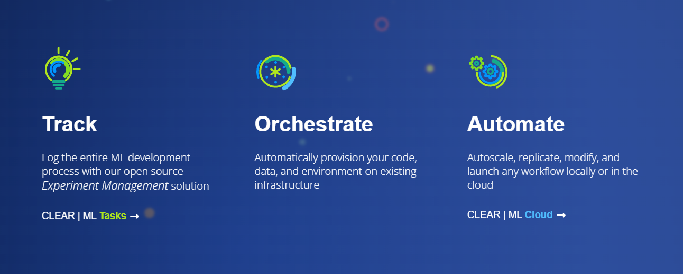
Enter, Clear ML ☺ for ML Ops
Mission : Accelerate ML Adoption, making ML seamless to integrate into any Software and Hardware product out there
Source : https://clear.ml/company/about-us/
Notes:
Their Mission is to Accelerate ML Adoption, making ML seamless to integrate into any Software and Hardware product out there
This tool will help Data Science and ML teams to orchestrate and automate ML experiments and workflow easily.

Slide 10
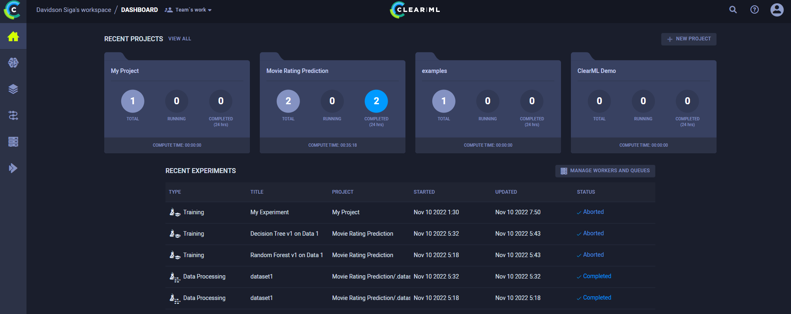
Easy to navigate UI
Source : https://app.clear.ml/dashboard
Notes:
Here’s a look at the harmless looking UI. It’s very intuitive to understand and easy to navigate.

Slide 11
ClearML Integration
ClearML + Movie Rating Prediction
Notes:
Now we shall look at how to integrate the Clear ML tool to our Movie Rating Prediction problem

Slide 12
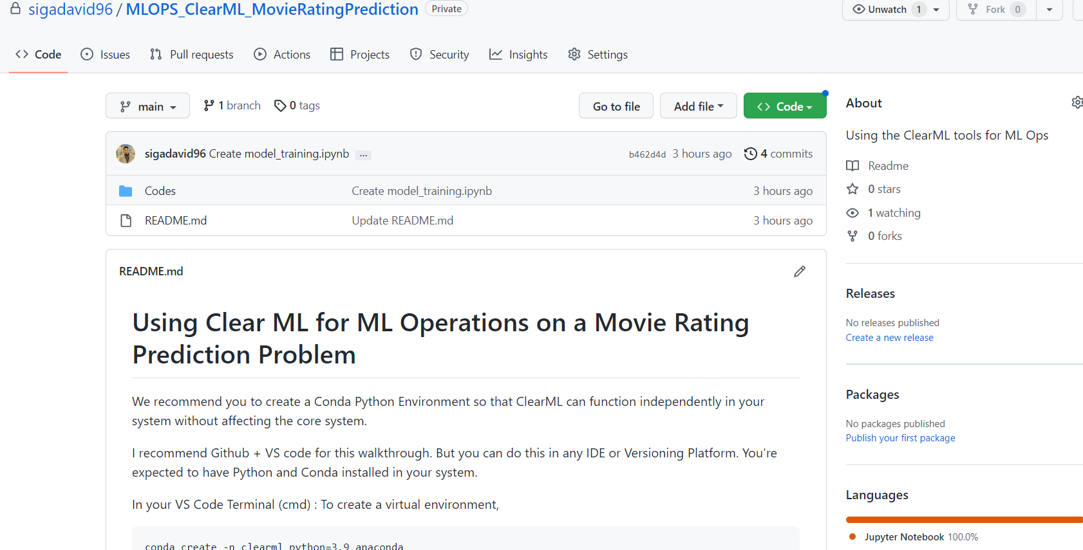
GitHub Walkthrough
https://github.com/sigadavid96/MLOPS_ClearML_MovieRatingPrediction
Notes:
I’ve created a GitHub Repo with an example to help you run the codes alongside me in this video. You can pause the video and download or clone/fork the repository for your convenience.
Now let’s look at the Repositry.

Slide 13
ClearML
The Strengths and Limitations
Notes:
Lastly, Let’s discuss the pros and cons of the clearML tookit

Slide 14

Strengths and Weakness
Strengths :
Very easy to integrate it to existing codes/system
Very appealing & Easy to Use UI
Very active & responsive community on Slack
100% Open Source Codes + Docker Hub
Weakness :
Only supports Python and not other statistical languages like R
The integration with SkLearn is only with JobLib and not as deep as Keras or Torch
Notes:
ClearML has larger benefits than weaknesses
Its very easy to understand, integrate and works well with most codes. It’s also 100% opensource, that means you can dockerize the app in your system for free!
The few weaknesses are regarding the lack of support to R and Sklearn libraries, but I'm sure that the community might find ways to bridge that gap too!

Slide 15
Thank you!
Happy to connect :)
Davidson Siga
dsiga@cmu.edu
linkedin.com/in/DavidsonSiga
MISM 16, CMU
Notes:
So that’s all about ClearML. It’s a great tool! And can help you improve the dynamics and results of an ML project. Do try it!
For any questions, please feel free to contact me via LinkedIn or Email

